Slide 1
Looking back at May & June – What the sales data told me
From big discounts to supplier shifts – here’s what stood out

Slide 2
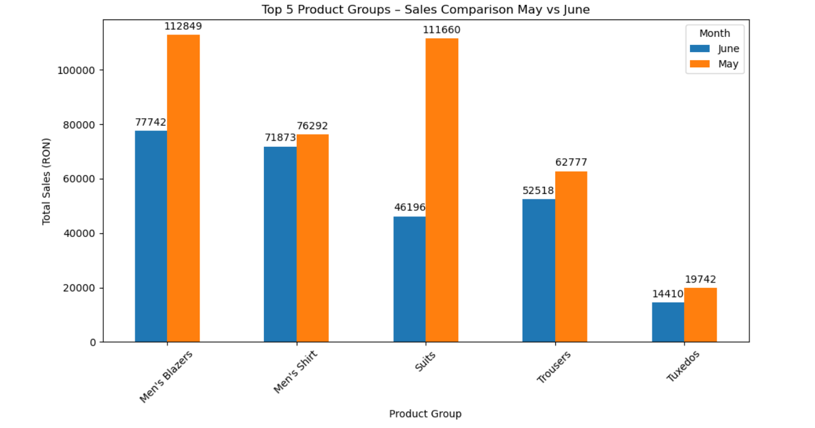
Product Group Performance May vs June Top 5 Product Groups by Sales
Men's Blazers: -31% (from 112,849 RON in May to 77,742 RON in June)
Suits: -59% (from 111,659 RON to 46,195 RON)
Trousers: -16% (from 62,777 RON to 52,518 RON)
Men's Shirts: -6% (from 76,291 RON to 71,873 RON)
Tuxedos: -27% (from 19,742 RON to 14,410 RON)
Most product groups experienced a drop in June. Blazers and Suits were the hardest hit.

Slide 3
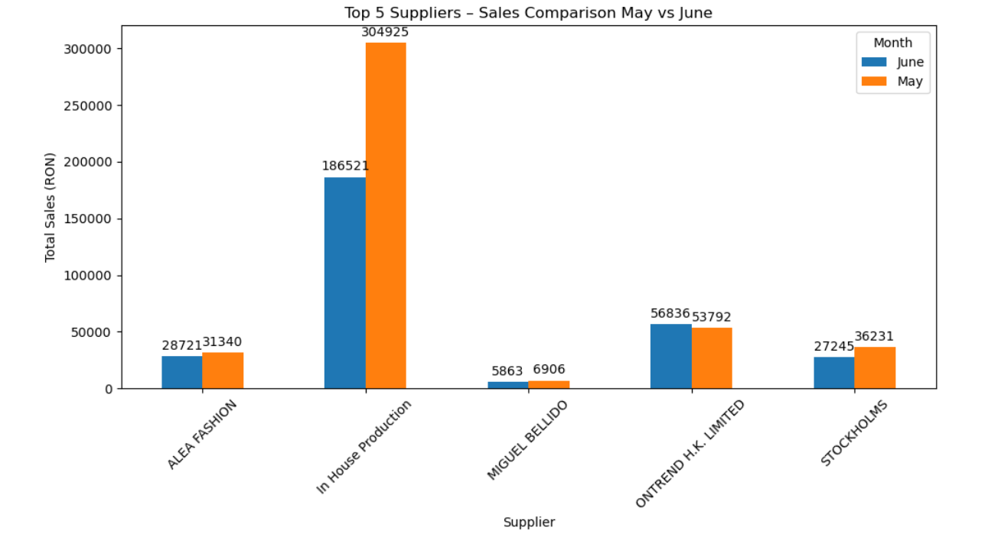
Supplier Sales Overview Top 5 Suppliers by Total Sales
In House Production: -39% (from 304,925 RON to 186,521 RON)
ONTREND HK LIMITED: +5.7% (from 53,792 RON to 56,836 RON)
ALEA FASHION: -8% (from 31,340 RON to 28,721 RON)
STOCKHOLMS: -25% (from 36,231 RON to 27,243 RON)
MIGUEL BELLIDO: -15% (from 6,906 RON to 5,863 RON)
Only ONTREND HK LIMITED registered a slight increase. All other suppliers sold less in June.

Slide 4
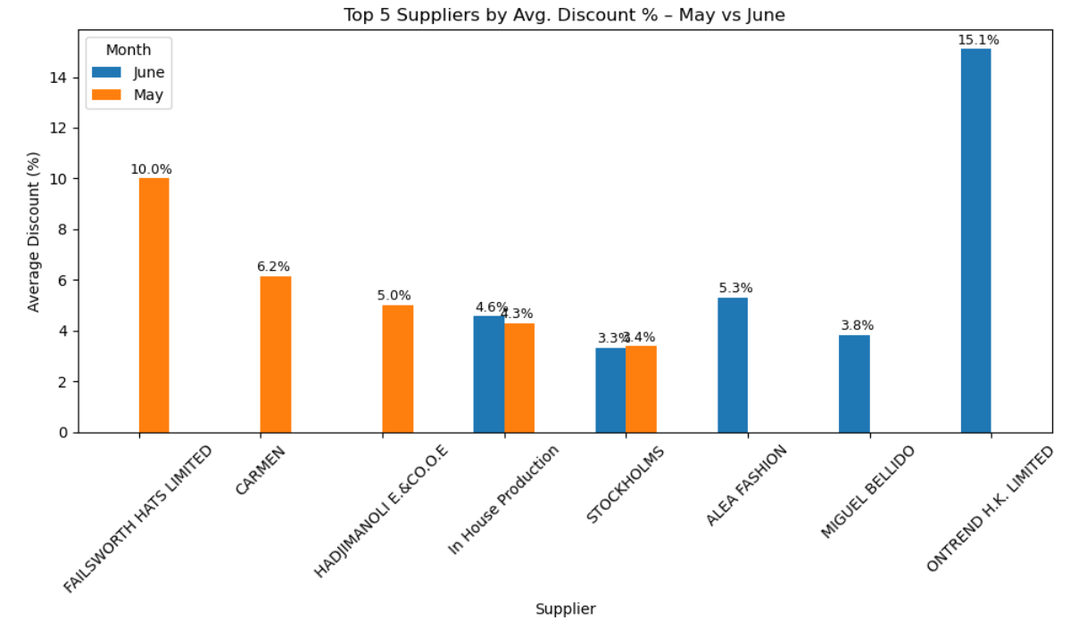
Discount Analysis Top 5 Suppliers by Avg. Discount %
HADJIMANOLE & CO.: Constant 5%
In House Production: Slight drop from 4.6% to 4.3%
STOCKHOLMS: Small rise from 3.3% to 4%
ALEA FASHION: Offered 5.3% in June (was not in top 5 May)
MIGUEL BELLIDO: 3.8% in June (was not in top 5 May)

Slide 5
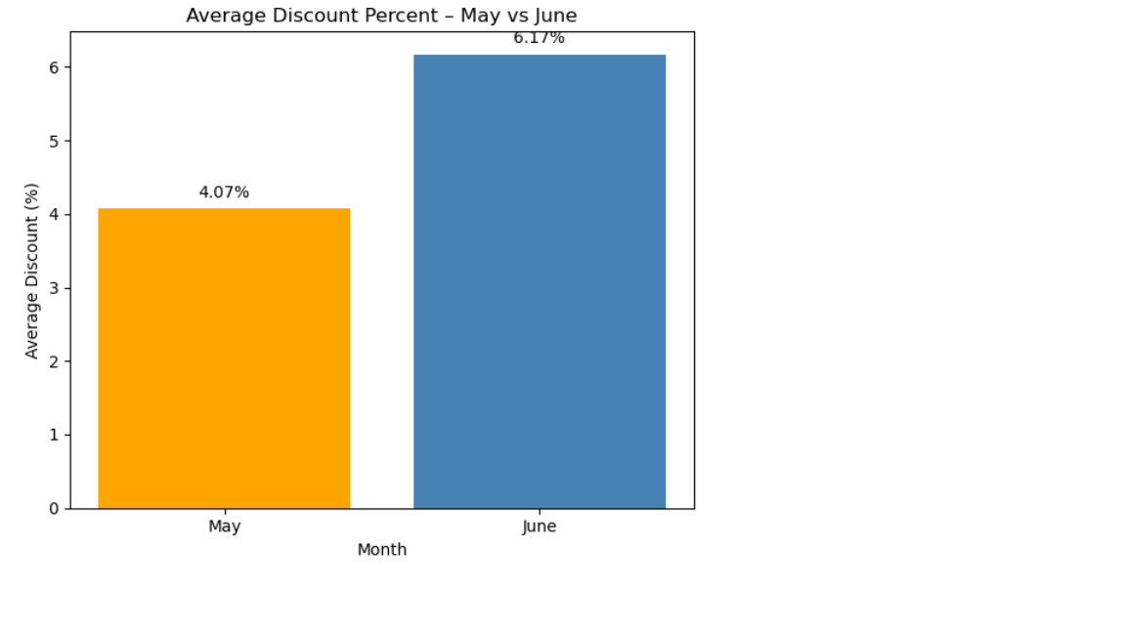
Overall Avg. Discount
May: 4.07%
June: 6.17%

Slide 6
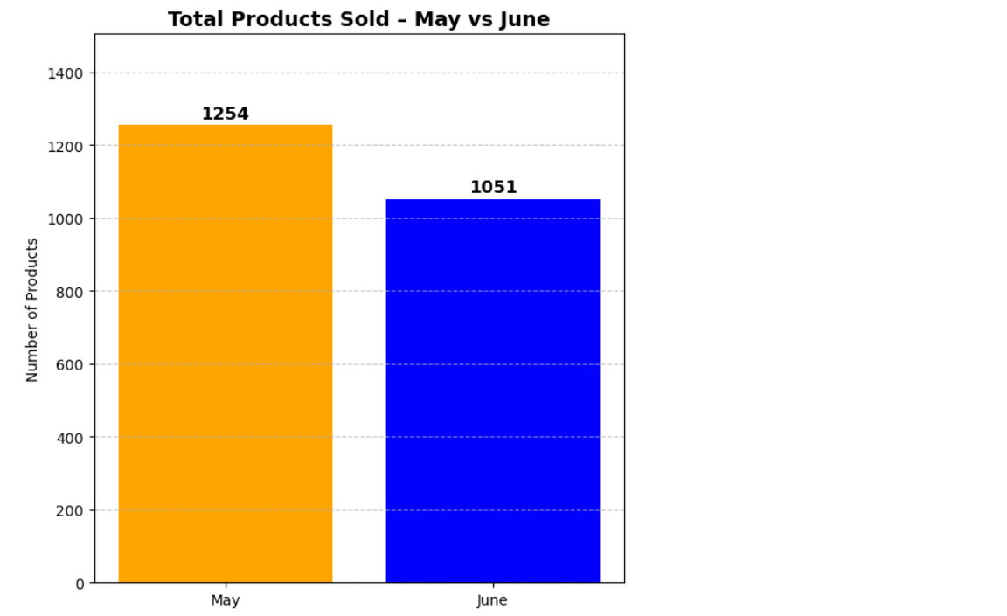
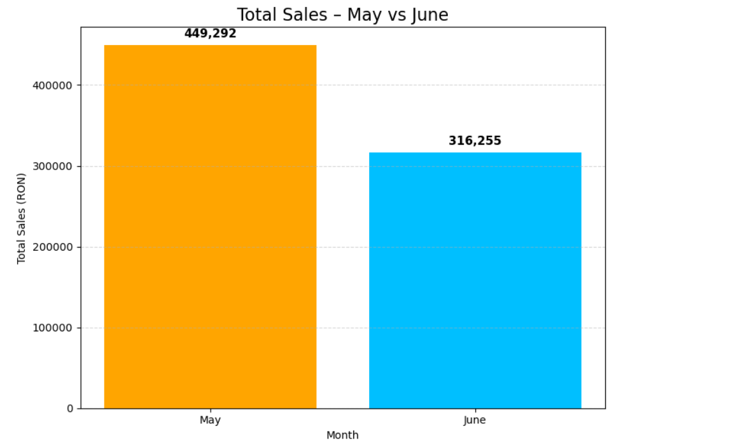
General Metrics
Total Products Sold
May: 1254
June: 1051, Down 16%
Total Sales (RON)
May: 449,291 RON
June: 316,255 RON

Slide 7
Key Conclusions And Recommendations
Key Conclusions
Sales volume and value both dropped in June.
Discounts went up, but did not help recover sales.
Core product groups like Suits and Blazers were heavily impacted.
ONTREND HK LIMITED was the only supplier showing growth.
Recommendations
Investigate reasons behind declining sales for Suits and Blazers.
Monitor discount strategy – higher discounts didn't boost volume.
Analyze why ONTREND HK LIMITED performed better and if similar patterns can be applied to others.
Consider adjusting stock or promotions in advance for high-performing product groups in future months.

